Slide 1

Enterprise Network Architecture
This project presents a robust and secure enterprise network architecture, leveraging Huawei Datacom technologies within a simulated eNSP environment. It addresses critical business objectives for a modern, distributed organization.

Slide 2
Team Members
Akram Usama
Husein Mohamed
Hanaa Elhamamy
Mohamed Ramadan
Mahmoud Rezk

Slide 3
Executive Summary
Building a Unified, Secure, and Resilient Enterprise Network
Our proposal delivers a comprehensive network solution connecting a Headquarters (HQ) and two Branch Offices (A, B,) over a simulated ISP. The architecture emphasizes secure connectivity, centralized service delivery, and high availability, crucial for today's distributed workforce.
1
2
3
Secure WAN Connectivity
Centralized Services
Traffic Isolation
Establishing robust and encrypted links between all sites.
Ensuring reliable access to critical HQ-based applications.
Enhancing security and performance through granular VLAN segmentation.

Slide 4
Project Objectives
Meeting Core Business Needs
Provide secure WAN connectivity between HQ and branches using encrypted tunnels.
Isolate network traffic efficiently using VLANs for different user groups and services (Employees, Guest, CCTV, Printers, Servers).
Ensure reliable access to HQ services: FTP, Voice over IP (VoIP), Closed-Circuit Television (CCTV), Authentication, Authorization, and Accounting (AAA), and Dynamic Host Configuration Protocol (DHCP).
Implement redundant DHCP services for continuous IP address allocation.
Establish centralized network management for simplified oversight and control.
Enable site-local services, including printing and local surveillance recording.
Secure network access to protect sensitive data and resources.

Slide 5
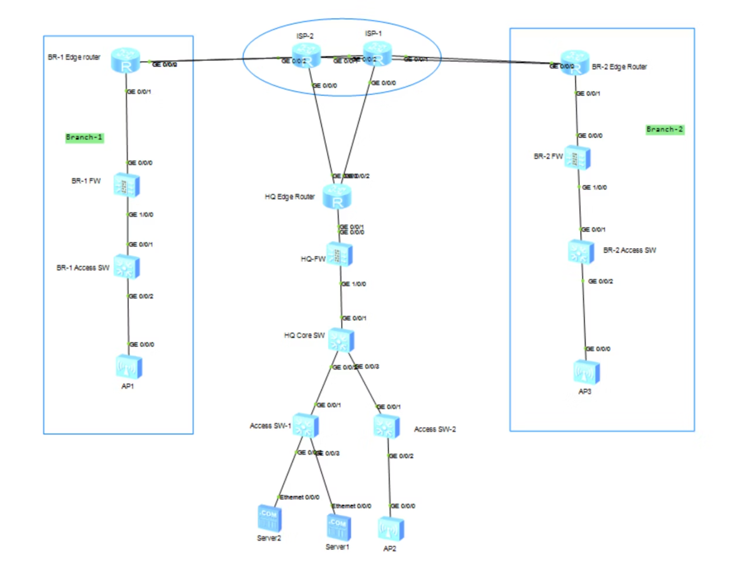
High-Level Design Overview
Architectural Foundation
Central Services at HQ
DHCP, FTP, AAA, VoIP PBX, and Core NVR.
ISP Connectivity
Routers at each site connect via PPPoE to the simulated ISP.
Secure Overlay
Huawei USG Firewalls establish VPN/IPSec tunnels for an SD-WAN overlay.
Local Access
Access Switches and Wireless Access Points (APs) provide wired and wireless connectivity.
Distributed CCTV
Local NVRs at branches capture CCTV, accessible from HQ.

Slide 6
VLAN Architecture
Segmentation for Security and Performance
Our VLAN strategy ensures effective traffic isolation, enhancing both security and network performance across all sites. The 'x' in the subnet represents the site number (e.g., HQ=1, Branch A=2, Branch B=3, Branch C=4).
VLAN ID
Subnet Example
Purpose
10
10.10.x.0/24
Employees
20
10.20.x.0/24
Voice/VoIP
30
10.30.x.0/24
Servers (FTP, AAA, PBX)
40
10.40.x.0/24
CCTV + NVR
50
10.50.x.0/24
Guest Internet
60
10.60.x.0/24
Printers
200
10.200.x.0/24
Management

Slide 7





Key Services Implementation
Enabling Core Business Operations
Central DHCP
Access Control (AAA)
CCTV Monitoring
HQ-based DHCP server relays IP addresses to all branches.
AAA server at HQ enforces employee authentication and authorization.
Local NVRs at branches capture footage, centralized to HQ NVR for unified surveillance.
Voice over IP (VoIP)
FTP Services
PBX at HQ, branch IP phones register securely via VPN tunnels for stable calls.
Secure file sharing restricted to the Employees VLAN for data integrity.
Additional services include a dedicated Printers VLAN for local office printing and a Guest VLAN providing Internet-only access secured via NAT at the USG firewall.

Slide 8
Security Measures
Protecting the Enterprise Network
A multi-layered security approach ensures data confidentiality, integrity, and availability across the entire network infrastructure.
1
Perimeter Filtering
2
Access Control Lists (ACLs)
Huawei USG Firewalls meticulously filter traffic between internal VLANs and the wide area network (WAN).
Granular ACLs limit access to sensitive resources like CCTV streams and FTP servers, enforcing strict authorization.
3
Wireless Security
4
Layer 2 Protection
Robust WPA2/3 encryption standards secure both Employee and Guest wireless networks, preventing unauthorized access.
DHCP snooping and ARP inspection are enabled on all access switches to mitigate common Layer 2 attacks, ensuring network integrity.

Slide 9



Acceptance Criteria
Validating Network Performance
The success of this network architecture will be rigorously measured against the following key performance indicators and functional requirements:
100%
MOS > 4
24/7
DHCP Functionality
VoIP Call Stability
CCTV Accessibility
All employee devices across HQ and branches must successfully obtain IP addresses from the centralized HQ DHCP server.
Voice over IP calls must maintain a Mean Opinion Score (MOS) consistently above 4, indicating excellent voice quality.
CCTV streams from all branch NVRs must be continuously and reliably accessible from the Headquarters' core NVR.
Internet Only
Local Reachable
Guest VLAN Isolation
Printer Accessibility
The Guest VLAN must strictly provide Internet-only access, with no reachability to internal network resources.
Printers must be reliably reachable and functional only within their respective local VLANs at each site.

Slide 10

Conclusion
A Foundation for Future Growth
This enterprise network architecture, designed with Huawei Datacom technologies, provides a scalable, secure, and highly available foundation for your organization's digital operations. By centralizing services and segmenting traffic, we ensure efficient resource utilization and enhanced security posture, ready to support evolving business needs.

